Slide 1
TEACHER INSTRUCTION PAGE (delete this slide)
3-2-1 Reading Summary Workbook
Student Activity: read a passage and complete the 3-2-1 graphic organizer.
How to share with students: These pages are sized for printing or can be assigned digitally using an LMS (like Google Classroom), where students can work on their own slide decks via “Make a Copy for Each Student.” Each slide is set up with text boxes for students to type in.
Please Note: Because Diffit resources can vary in length, be sure to check the formatting on each slide.
Suggested Lesson Flow:
Students complete a Notice/Wonder Image Analysis
Have students read the passage and take notes.
Complete the 3-2-1 Graphic Organizer
Have students go through the Multiple Choice Questions. Students will answer each question and explain their thinking.
Have students complete the Short Answer Questions.
Have students complete the Open Ended Questions and discuss with partners or groups their responses.
Feel free to edit, remix, and use this resource however works best for you and your students! Find editing tips here!
Learn More: Please reach out with any questions or feedback. You can also learn more on our FAQ page, or get more resources at Diffit.me!
TEACHER INSTRUCTION PAGE (delete this slide)

Slide 2
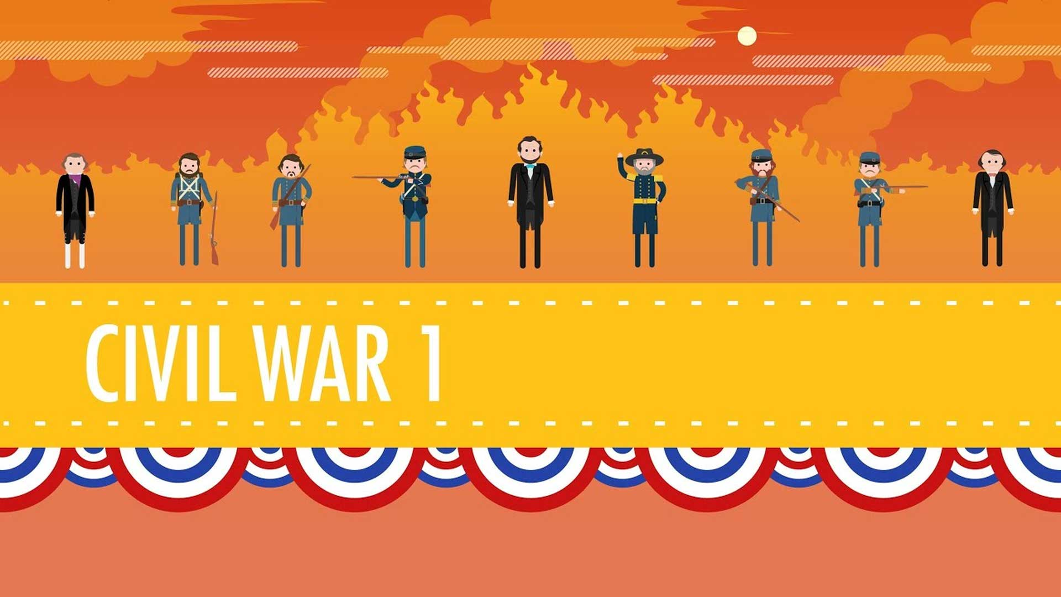

Slide 3
autonomy
fealty
prosaic
rhetoric
turning point
the right or condition of self-government, especially in a particular sphere.
loyalty and allegiance to a superior or sovereign.
lacking poetic beauty; commonplace or dull.
the art of effective or persuasive speaking or writing, especially the use of figures of speech and other compositional techniques.
a time at which a decisive change in a situation occurs, especially one with beneficial results.

Slide 4
Hi, I'm John Green. This is Crash Course US History, and today we come at last to the Civil War, the conflict that in many ways created a nation. So here's what you won't be getting today. We will not be describing battles and tactics. If that's your bag, might I suggest Ken Burns or if you prefer books, like 1000 authors, my favorites being James McPherson and Shelby Foote. And 2. We won't be bashing and/or praising Abraham Lincoln very much, although we do have multiple Lincolns here because we've heard that's good for ratings. I mean, to watch or read certain accounts, you would think that the Civil War was a lengthy chess game played by Abraham Lincoln against his cunning opponent Abraham Lincoln, but of course there were other people involved. We are going to quote a fair bit of Lincoln, though, because, you know, that won Tony Kushner an Academy Award nomination.
3. We won't be claiming that the Civil War was somehow secretly about something other than slavery, because that is just so early 20th century. And 4. There will not be a lot of jokes today because hahaha 700,000 people died. Mr. Green, actually only 680,000 people died. Yeah, it depends on how you count, you sniveling little ghoul. But recent estimates are between 680,000 and 800,000 total casualties. Deadlier for Americans than the American Revolution, World War I, World War II, and Vietnam combined. So let's start with some basic facts about the American Civil War. 1861 to 1865, which corresponded with the presidency of Abraham Lincoln. The Union, or more colloquially the North, fought against the forces of the Confederate States of America, or the South. Sometimes people call the Union 'the blue' and the confederates 'the gray,' but in fact the uniforms weren't very uniform, they were all different kinds of color.
And also, with all that dirt and blood, they were all just brown. Alright, let's go to the Thought Bubble. You'll notice from this map that not all the states that held slaves were part of the Confederacy. The border states of Kentucky, Missouri, Delaware and Maryland allowed slavery and never left the United States. All of these border states were critical to the Union--Maryland was north of the nation's capitol in Washington D.C.; Kentucky controlled the Ohio River; Missouri was the gateway to the West; Delaware actually wasn't that important. So none of that should be particularly controversial, unless you're from Delaware, but the causes of the war, that's another story. The Civil War was about slavery--actual historians will back me up on this, like David Goldfield, who wrote, "Both Northerners and Southerners recognized slavery as the immediate cause of the Civil War.
" Also, Lincoln said in his second inaugural address, "One eighth of the whole population were colored slaves, not distributed generally over the Union, but localized in the southern part of it. These slaves constituted a peculiar and powerful interest. All knew that this interest was, somehow, the cause of the war.That said, in comments lots of people will be like, the war was about agriculture versus industry, or the states’ rights to protect themselves from the tyranny of a big federal government, but if it were REALLY about that, the Civil War would’ve started during the Nullification crisis in the 1830s, when-- as I’m sure you’ll remember--Andrew Jackson said that South Carolina couldn’t declare a federal tariff null in their state. Why didn’t that cause a Civil War? The Confederate government passed the first conscription act in American history, implemented national taxes, created a national currency, and had a government bureaucracy of about 70,000 people, more than the federal bureaucracy in Washington D.C. Thanks, Thought Bubble.
That said, in the beginning of the war, Lincoln deliberately tried to downplay the slavery angle, arguing that the war was only about preserving “the Union.” But the war was also about religion, for both sides. As David Goldfield put it, “In protecting the Revolutionary ideals, northerners would preserve God’s plan to extend democracy and Christianity across an unbroken continent and around the world. Southerners welcomed a war to create a nation more perfect in its fealty to God than the one they had left.” But it’s also important to remember that regular soldiers often had more prosaic reasons for going off to fight, as you will eventually learn when you are forced to read The Red Badge of Courage, Goldfield tells the story of one Alabamian who enlisted only after his girlfriend mailed him a dress and told him he should start wearing if he wasn’t willing to go fight.
And for Northerners, Union, religion and an end to slavery mixed together to form a potent rationale for war. It’s summed up nicely by Julia Ward Howe’s words to the song that would become famous as the Battle Hymn of the Republic: “As he died to make men holy, let us die to make men free.” You thought I was going to sing, but you were wrong.
So spoiler alert the Union won the war, which in a sense was unsurprising, because they had massive advantages: For starters, they had many more people, approximately 22 million as compared to 9 million in the South, of whom 3.5 million were slaves and therefore unlikely to be sympathetic to the Southern cause. Also, the north manufactured more than 90% of all goods in America; its factories turned out 17 times more textiles than the South, 30 times more shoes and boots, 13 times more iron, and 32 times more firearms.
Plus, at the outbreak of the war the North had twenty thousand miles of railroad compared with the South’s ten thousand. This made it easier for the Union to move its army, which over the course of the war enlisted more than 2 million men, compared with 900,000 for the Confederacy. Even northern agriculture was also more productive, taking greater advantage of mechanization than southern farmers did. Really the only advantage the south had was better leaders, like most of the tactically famous generals of the Civil War, Robert E.Lee, Stonewall Jackson, J. E. B. Stewart, etc., were Southerners. And also, by the way, they all had great last words. Lee said "Strike the tent," Stonewall Jackson said "Let us cross over the river and rest under the shade of those trees," and JEB Stuart after being mortally wounded in battle said to his close friend and lieutenant, "Honey-bun, how do I look in the face?
" Famous Union general Ulysses Grant's last word was "Water," which isn't near so good, but he said that last word after having survived the war and getting to be, like, President of the United States and stuff. Right but anyway, this all raises an interesting question: Was the result of the war a foregone conclusion? The Confederacy had to create a nation from scratch and build national unity among people who were committed to the autonomy of their individual home states. So that's a problem. And, then there was the issue of overcoming class conflicts, especially when the ruling class was often exempted from actually fighting in the war. But when you put aside all that nation-building stuff and just focus on the actual fighting of the war, the question of the union's inevitable win becomes much trickier.
Some have argued that all the Confederacy really to do was outlast the Northern efforts to bring them back into the Union, like Washington had to do against the British. And the idea was that the war of attrition would eventually wear down northern resolve. But, there were two problems with this theory. First, the North had such superiority in its resources that it would take a long time to wear down. Secondly, fighting a war of attrition would be costly to the South, as well and their resources would be depleted long before the North's. Oh it's time for the Mystery Document? The rules here are simple. Woah! That was intense. I try to identify the author of the Mystery Document. If I am right, I do not get shocked, but I'm never right because Stan makes it too hard. Alright, let's see what we've got today.
"I therefore determined, first, to use the greatest number of troops practicable against the armed force of the enemy, preventing him from using the same force at different seasons [and] second, to hammer continuously against the armed force of the enemy and his resources, until by mere attrition ... there should be nothing left to him but submission." Okay so the strategy of attrition was a Confederate strategy. But, Stan is a jerk. But it talks about the enemy AND HIS RESOURCES, which was kind of a Union focus. And more importantly, it talks about preventing him from using the same force at different seasons. That makes me think it is a Union general. Final answer Ulysses S. Grant. OH HOW DO YOU LIKE THEM APPLES. Grant was different from previous Union generals in that he was willing to sustain enormous casualties in pursuit of his goal to wear down the South.
Because of this, Grant was branded a butcher, like he was willing to weather incredible losses including the 52,000 men -- 41% of his army -- who were injured or killed at the battles of the Wilderness and Cold Harbor.But his grim determination not just to defeat but to destroy his opponent is what made Grant one of the first truly modern generals and also the most successful leader the Union found. So, Grant’s brutal strategy coupled with the vast superiority in Northern resources suggests that the outcome of the Civil war really was inevitable, but it also points to some of the reasons to be cautious about that conclusion.
First off, it took three years before the Union actually fully adopted Grant’s strategy, and between 1861 and 1864 it was possible that Southern victories would eventually force the Union to give in. I mean, the Union lost a lot of battles in the first two years, largely due to ineffective General-ing and nothing saps a nation’s motivation for war like losing.
Now, some argue that the North had superior motivation to prosecute the war because they had God on their side and they were against slavery, but that’s also pretty problematic. I mean, for many men who joined the federal army, a war to end slavery had very little appeal, especially poor enlistees who might be afraid that newly-freed slaves would compete with them for jobs. Also, while we are correct in considering slavery unjust, southerners who took up arms for the Confederacy saw themselves as engaged in a fight for their own freedom, rather than a fight to protect slavery.
The truth is, when it comes to fighting, motivation is a very tricky business, and I’m most comfortable agreeing with James McPherson who argued that motivation waxes and wanes with victory, and that the outcome of the war was contingent on a number of turning points. And we’re just gonna discuss two of the most important: July 1863 and August 1864.
July 1863 saw two of the most important Union victories in the whole war. In the western theater, General Grant laid siege to and captured Vicksburg Mississippi, thus giving the federals control of the lower Mississippi river. I mean, by then, the North already had New Orleans, which made it pretty much impossible for the Confederates to ship cotton or anything else along the Mississippi River. After that, Grant was able to turn his attention to the east with the aforementioned hammering of the enemy and their resources.
More famously, especially in the eastern part of the United States, the first three days of July 1863 saw the battle of Gettysburg in Pennsylvania. This was General Lee’s furthest major offensive in the north and had he won the battle it is likely that panic would have set in in places like Philadelphia and maybe even New York.
Actually panic did overcome New York in draft riots that killed more than 100 people and only ended after troops from Gettysburg were called in. I’m not going to go into detail about either of these battles, but they shifted the tide of the war in favor of the North, although not enough to bring the war to a quick end. Confederate forces would never again threaten a northern city.
August 1864 saw another turning point that really spelled the doom of the Confederacy, and that was when Union general Sherman took Atlanta. Atlanta was a railroad hub and manufacturing center but its capture was more significant politically than militarily.Because it happened close to the election of 1864, and that American election was really the last time that the Confederate states of America could have won the Civil War.
It’s easy to forget this, but Lincoln actually had to run for reelection during the Civil War, and by the summer of 1864, the war was pretty unpopular and it looked like Lincoln might lose. The capture of Atlanta changed public opinion about Lincoln and meant that his Democratic opponent and former top general George McClellan didn’t stand a chance of winning, which was really significant for the war because Lincoln was committed to ending it with a Union victory and McClellan, meh. I think it says a lot about American history that in the end the war’s outcome was insured not just by military victories but by a political one. Next week, we’ll examine the effects of the Civil War and the enduring questions that have arisen out of it, such as who, exactly, freed the slaves? But, until then, thanks for watching.
Crash Course is produced and directed by Stan Muller. The script supervisor is Meredith Danko. Our show is written by my high school history teacher, Raoul Meyer, and myself. Our graphics team is Thought Café. And our associate producer is Danica Johnson, also responsible for felt Abraham Lincoln. If you want to suggest captions for the libertage, you can do so in comments where you can also ask questions about today’s video that will be answered by our team of historians. Thanks for watching Crash Course and as we say in my hometown, don’t forget to be awesome.

Slide 5
1. According to the text, what were some advantages that the Union had over the Confederacy during the Civil War?
A) The Union had better leaders and superior motivation.
B) The Union had more people, factories, and resources.
C) The Union had control of the lower Mississippi River and Atlanta.
D) The Union had a stronger belief in God and a greater desire to end slavery.
2. What was the significance of the battles of Gettysburg and Vicksburg?
A) They marked turning points in the war that shifted the tide in favor of the Confederacy.
B) They led to panic in northern cities and ultimately resulted in Confederate victories.
C) They were major Union victories that weakened the Confederacy and boosted Northern morale.
D) They were inconsequential battles that had no impact on the outcome of the war.
3. Why was the capture of Atlanta significant for President Lincoln's reelection campaign?
A) It ensured a victory for his Democratic opponent, George McClellan.
B) It changed public opinion about Lincoln and secured his chances of winning.
C) It had no political implications and only affected military strategy.
D) It caused a shift in the Union's focus from the war to the election.

Slide 6
Short Answer Questions
1. What were the two main sides in the American Civil War?
2. What were some advantages that the Union had over the Confederacy during the war?
3. What were some turning points in the Civil War that shifted the tide in favor of the Union?

Slide 7
1. Reflect on the significance of the Civil War in shaping the nation. How do you see its impact in your own life or community?

Slide 8
2. Consider the motivations and beliefs of soldiers who fought in the Civil War. How do their reasons for fighting compare to the reasons people engage in conflicts today?

Slide 9
3. Think about the role of leadership in times of war. How does the leadership displayed during the Civil War relate to examples of leadership you have witnessed or experienced?

